Slide 1
Robotics and IoT Club Secondary Years Level 2 - Week 11
Roohi Banu

Slide 2
How to Control Our Car Using ‘RF’
??

Slide 3
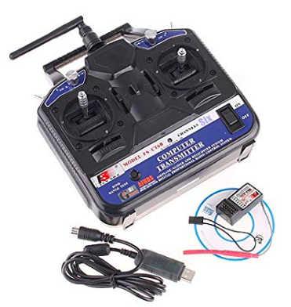
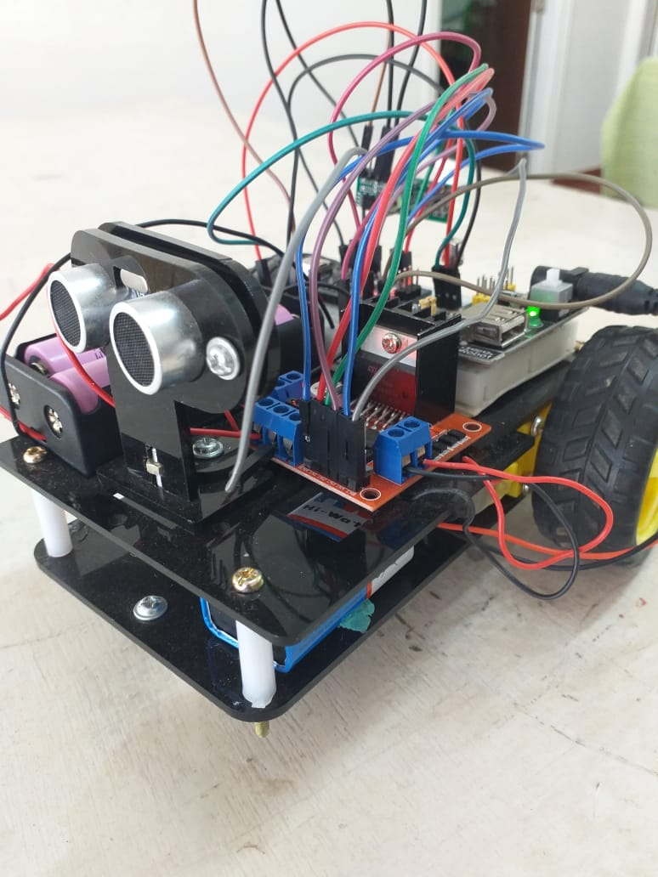
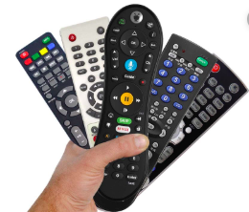
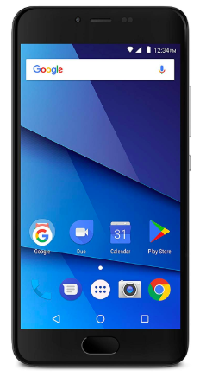
So far….
RF
IR
Bluetooth

Slide 4
What is Internet?
Connecting one computer/laptop/phones to another computer/laptop/phone
Connecting cables, routers, switches, hubs etc.
BIG GIANT NETWORK of computers/laptops/phones/

Slide 5
Internet of Things - IoT
What is Internet?
Traditional Internet was all about People - sharing their experiences, their services, the information with the other People.
In short Internet was – By the People, For the People and About the People.

Slide 6
Internet of Things - IoT
Traditional Internet was all about People Things - sharing their experiences, their services, the information with the other people Things.
In short IoT was – By the People Things, For the People Things and About the People Things.

Slide 7
What will you do with IoT?
Possibilities are endless and ONLY limited by our imagination
Monitor things – wireless cardiac heart monitor
Reality search engine – ‘Where are my glasses?’ Where is my child? Where is my Pet?
Manage our mega cities – smart city, better use of renewables, traffic solution, better use of energy resources
Control ‘Things’ –
Play with ‘things’ -

Slide 8
Few Projects we have done with IoT
Automatic Milk Order
Automatic Alcohol Detection (Drivers)
Health Monitoring
Pollution Monitoring

Slide 9
Smart Phone ’Things’
It knows where you are – GPS Sensor, Magnetometer
It knows how far your phone is from your ear - Proximity sensor
It knows whether you are moving – Motion sensor
It knows how bright are surroundings – Light sensors
It can sense how hot it is in this room – Temperature sensor
It can sense the humidity and probably pollution around here –Humidity & Pollution Sensors
It can see surrounding - Camera
It can communicate – Voice recognition sensors and Speaker

Slide 10
How?
Give things unique identity (current addressing protocol for the Internet IPV6 will provide unique identity)
We have to give ‘things’ senses
Give ‘things’ ability to communicate
Control ‘things’ – using small embedded systems

Slide 11
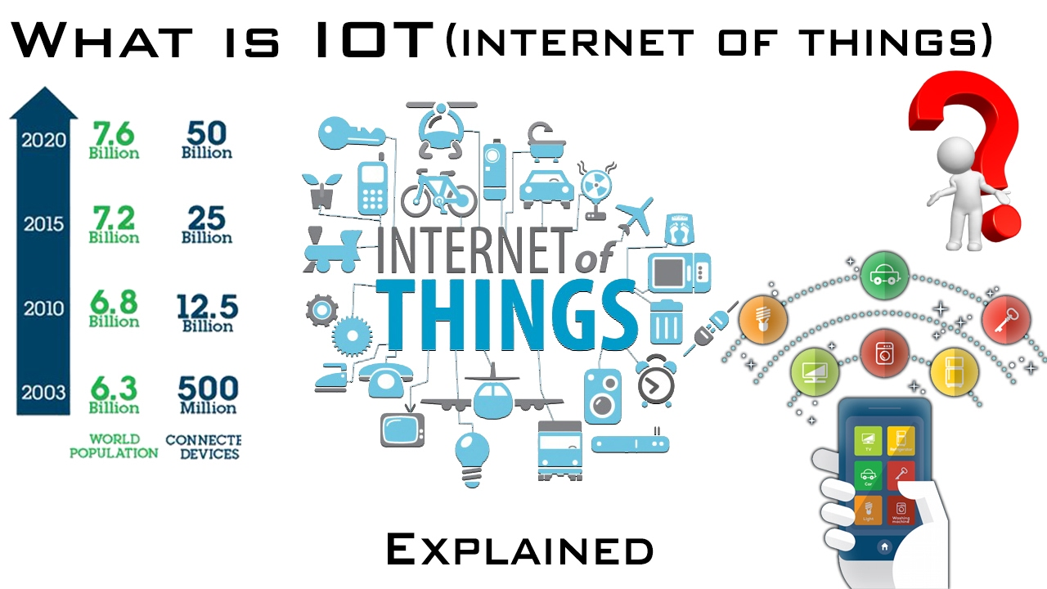
How Big is IoT?
In 2014 – 10 Billion devices - 1.5/Person
By 2020 – 50 Billion devices - 8/Person
By 2030 and 2040 – 2000 to - 5000/Person

Slide 12
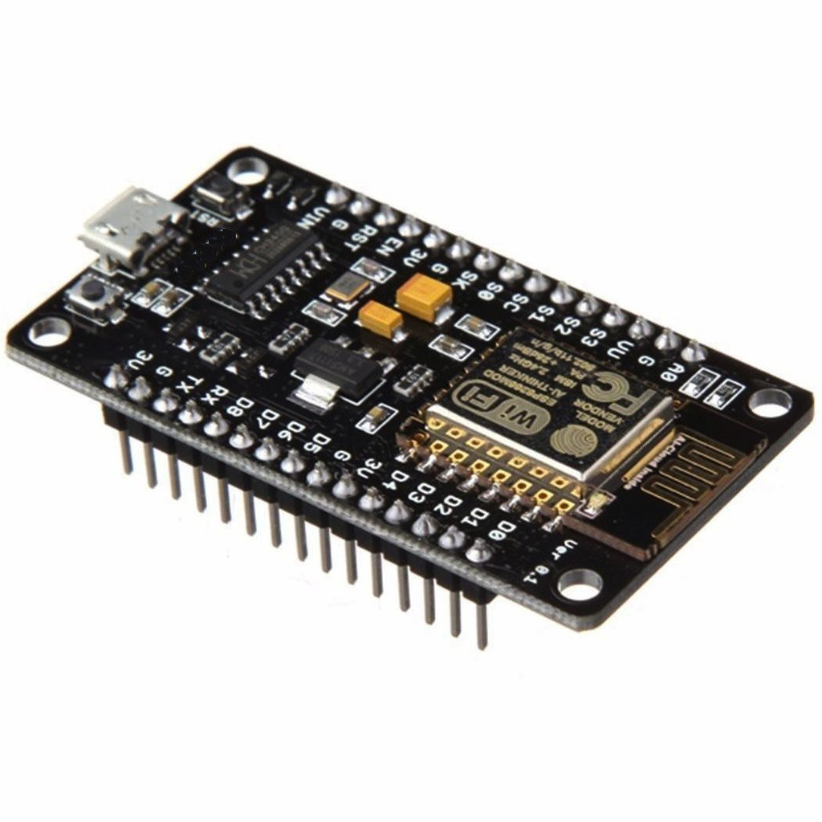
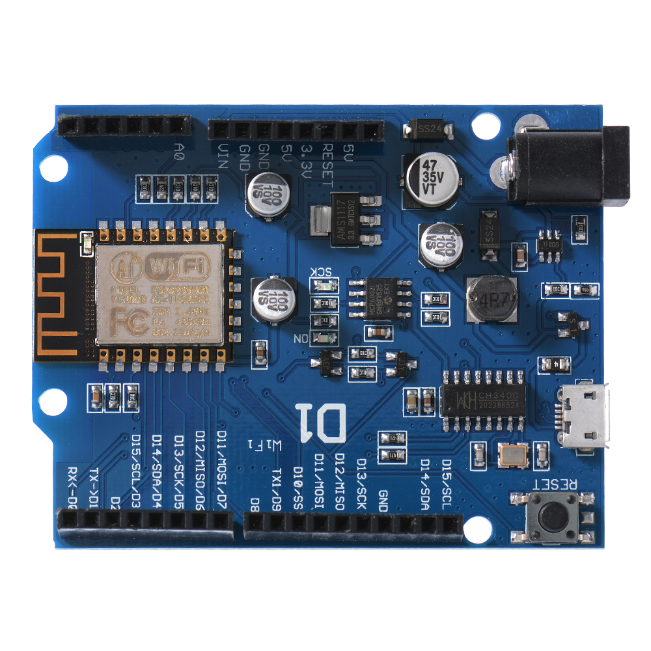
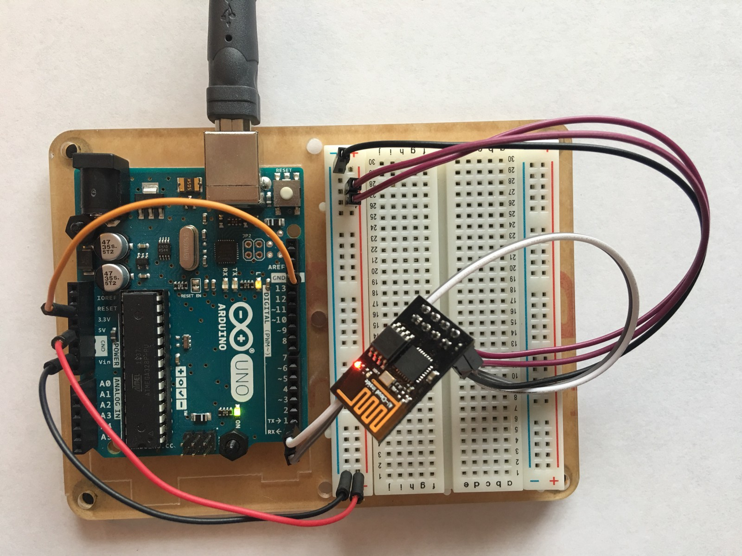
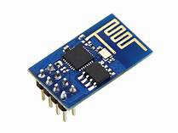
IoT
There are three ways to connect Arduino to wifi:
Using ESP8266 SOC Chip. ESP8266 is a low-cost wifi microchip with full TCP/IP stack for network connectivity
Arduino + ESP8266 Wifi module
Node MCU
WeMoS D1 - D1 board is compatible with Arduino UNO
Using ESP8266 wifi interface module
Arduino + ESP8266 wifi module.
Node MCU
ESP8266 wifi module
WeMoS D1

Slide 13
First things First
On your phone
blynk.io
Install Blynk app : available for
Create new account

Slide 14
First Things First
Download library from www.blynk.io
For Arduino C++ library ‘blynk_library_v0.6.1.zip’
Sketch -> Include Library -> Add .zip library
You may need to download ESP8266wifi-master library from github
Add this to
Arduino -> Preferences -> https://arduino.esp8266.com/stable/package_esp8266com_index.json
We need to add ‘esp8266 boards’
Tools -> Board -> Boards Manager
Go to ‘Example Code Builder’ in www.blynk.io
Choose Board -> WeMos D1
Connection -> ESP8266 WiFi
Example -> DHT11
Copy that file into Arduino IDE New File
Save the file

Slide 15
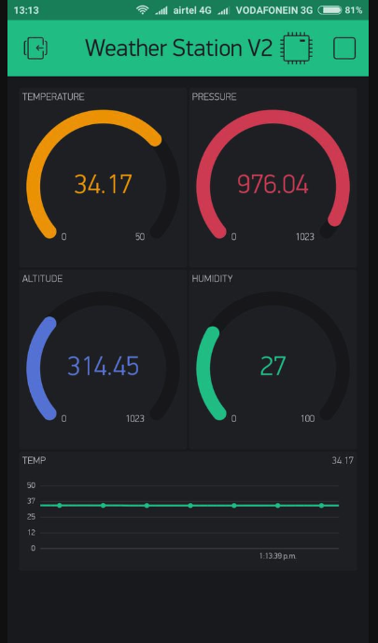
Blynk App
Create New Project
Choose Device -> ESP8266
Connection Type -> Wifi

Slide 16
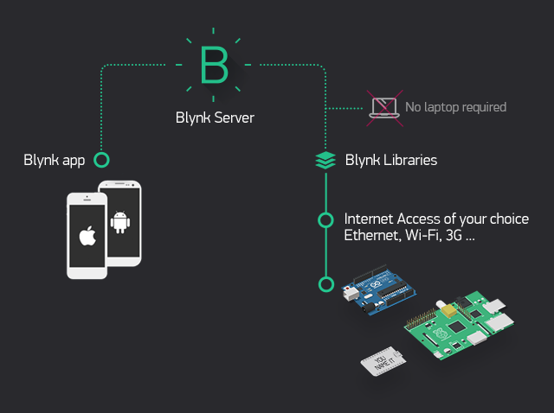
Blynk Architecture

Slide 17
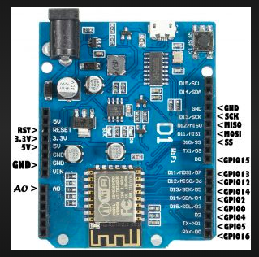
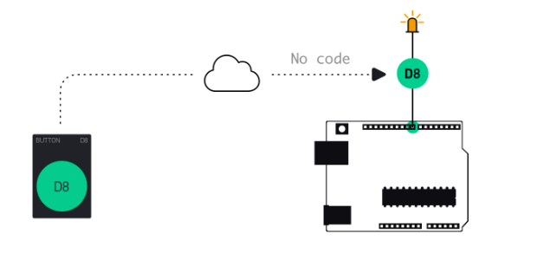
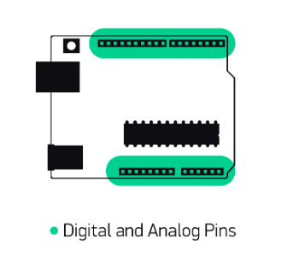
Blynk – Control LED – Direct Pin

Slide 18
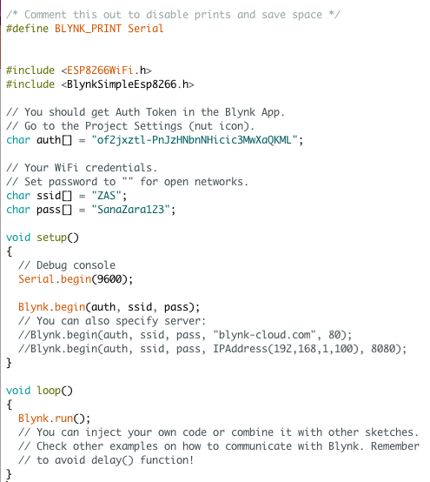
Simple Code

Slide 19
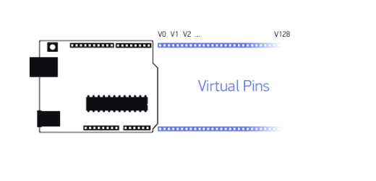
Virtual Pins

Slide 20
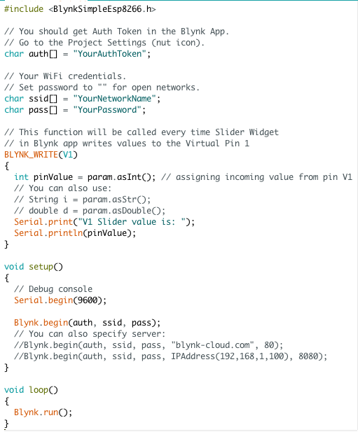
Control LED Using Virtual Pins
Code Builder
GetData

Slide 21
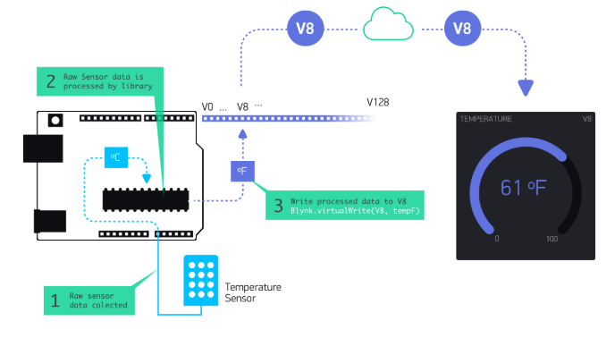
DHT11

Slide 22
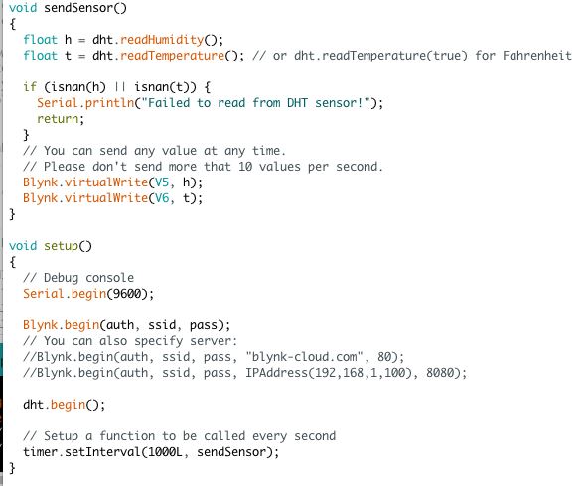
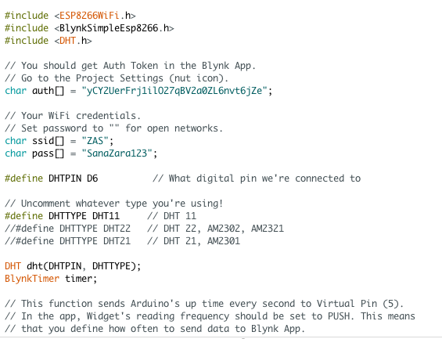

DHT11

Slide 23
Virtual Pins

Slide 24
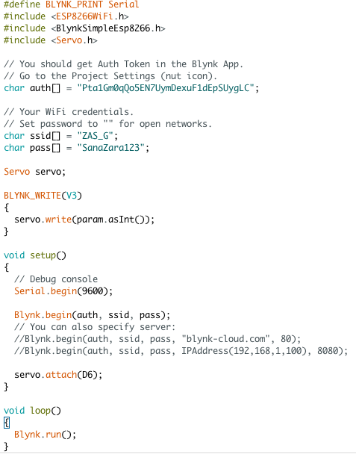
Servo Motor

Slide 25
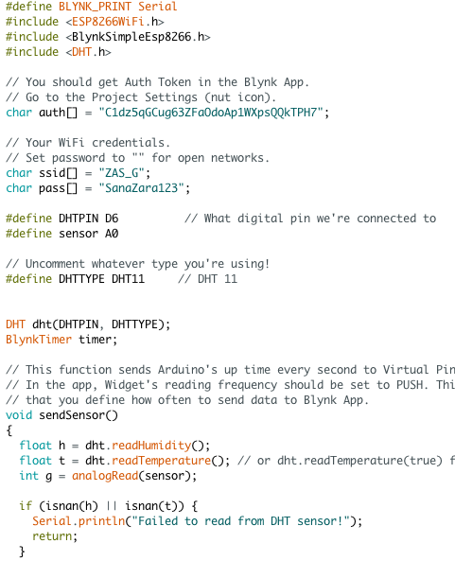
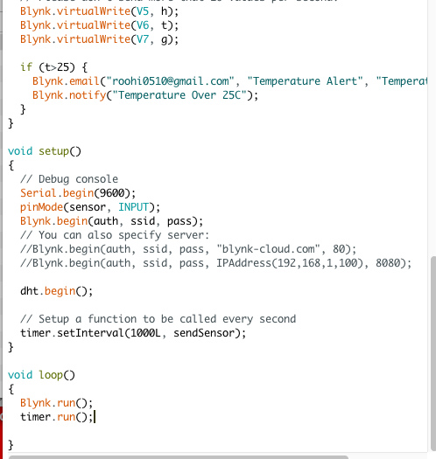
DHT + Pollution Sensor

